Slide 1
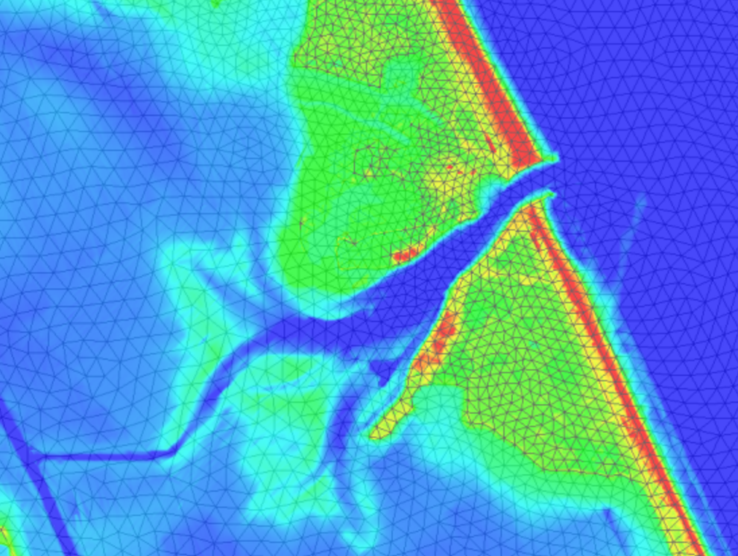
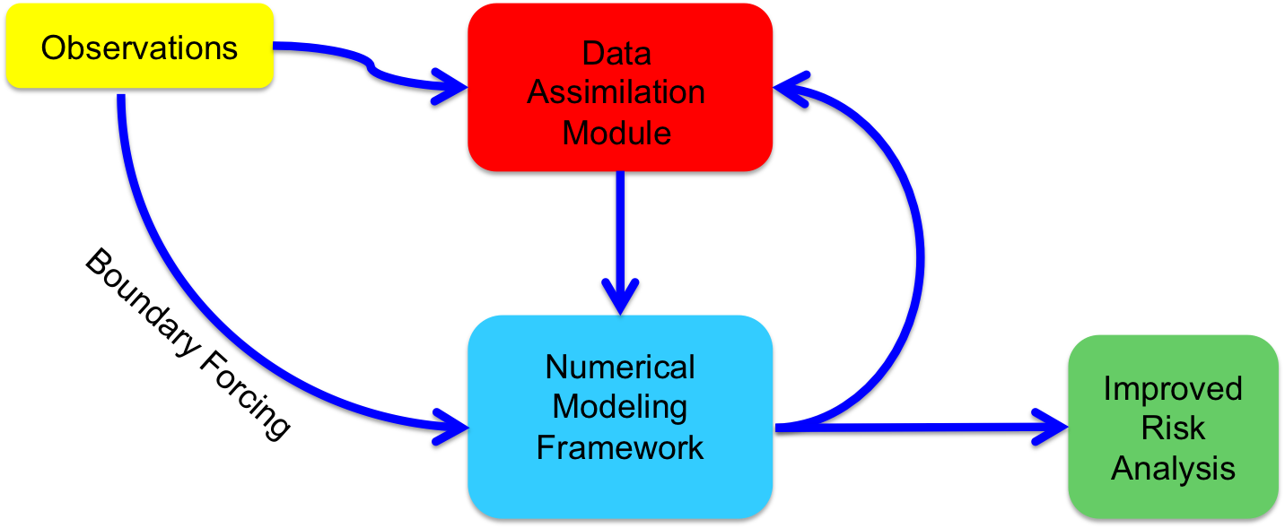


Development of Model-data Assimilation framework
Tyler Hesser, PhD
Matthew Farthing, PhD
Coastal and Hydraulics Laboratory
US Army Engineer R&D Center
22 June 2017

Slide 2
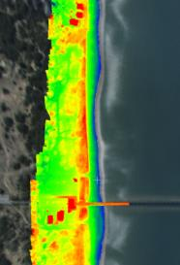
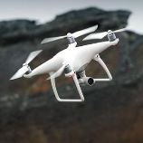

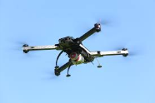
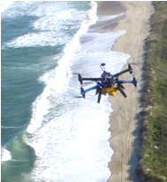
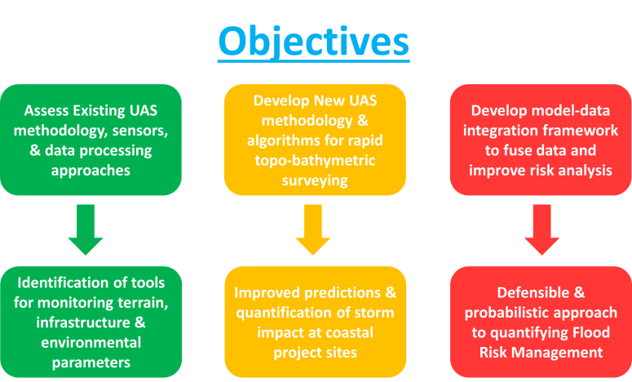
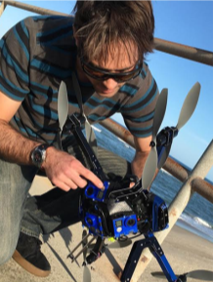
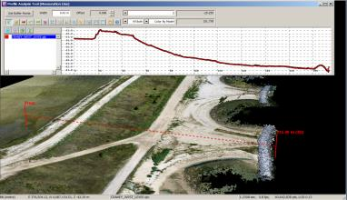
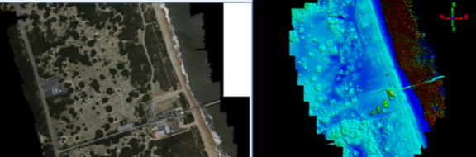
UAS support to frm
GOAL: “To identify and develop defendable and consistent Unmanned Aerial System (UAS)-based methodology and data products that seamlessly integrate with numerical models to monitor topography and bathymetry, storm-damage reduction infrastructure, and ecosystem health to improve USACE’s management of flood risks.”
Multi-Lab initiative (CHL/GRL/EL/CRREL)
Funded by: Flood & Coastal, CODS, CFDC

Slide 3
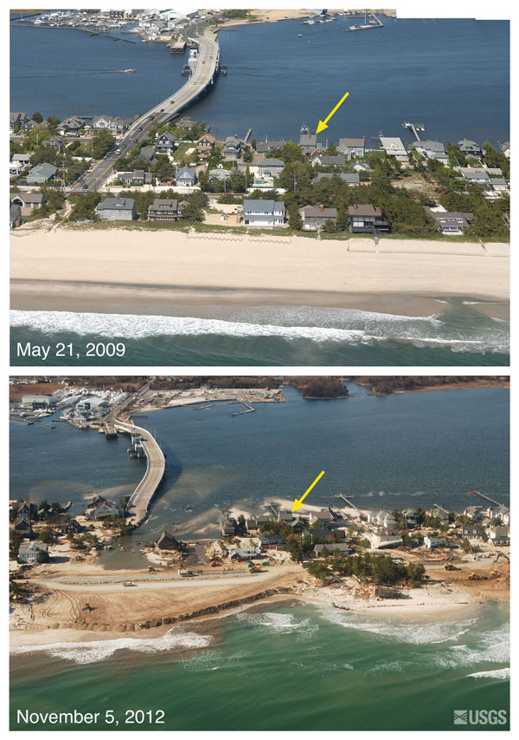
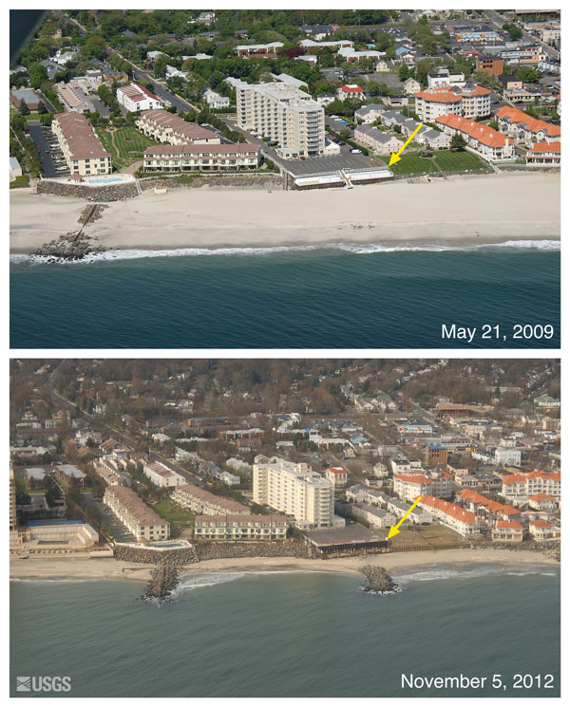
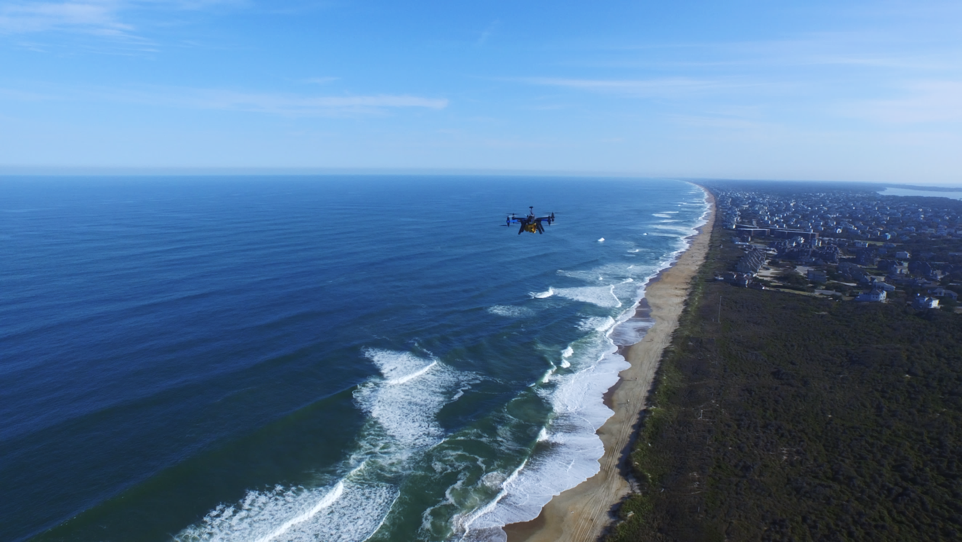
Neashore Data Assimilation Framework
PI – Tyler Hesser
Combine UAS data sources using data assimilation framework
Use novel and well tested black-box data assimilation schemes to combine:
Beach topography
Dune shape
Vegetation growth
Historical LIDAR bathymetry
Inverted bathymetry from sea surface measurements
Capabilities/Applications
Data assimilation framework to combine data from multiple UAS platforms
Couple data assimilation tools with existing USACE flood risk numerical prediction models
Build short term forecast using USACE tools for flood risk
- Use data assimilation to build an accurate forward prediction model for flood risk.
Data assimilation framework provides an estimate of pre-storm conditions
Super-storm Sandy led to wide spread beach erosion from Virginia to New York.
UAS observations provide pre-storm conditions

Slide 4
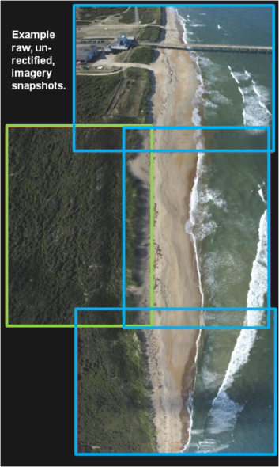
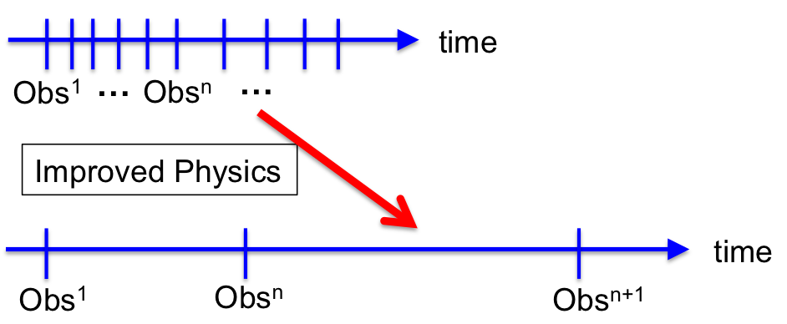

What is the role of data assimilation with uas technology?
UAS technology provides a unique observation of the environment at a single time.
Lack of continuous observation reduce the accuracy of the inversion analysis
Higher fidelity physics can pull more out of observation data sets and improve prediction between observations

Slide 5
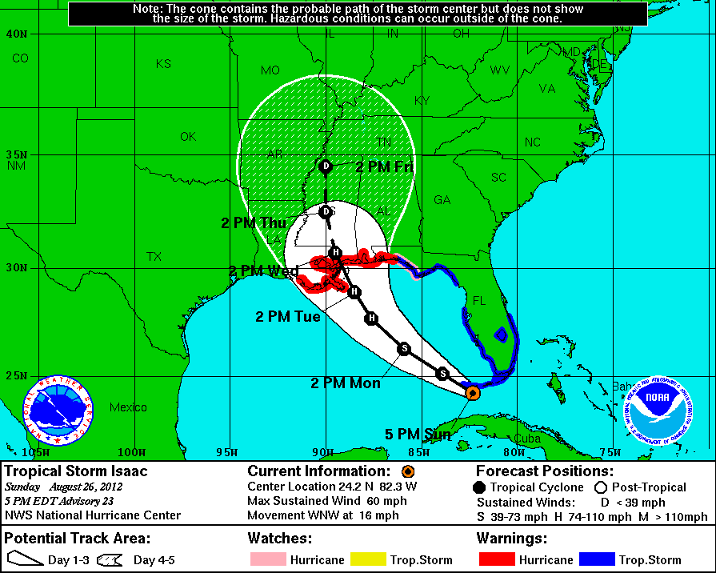
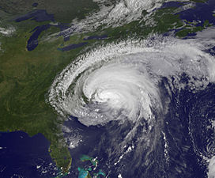
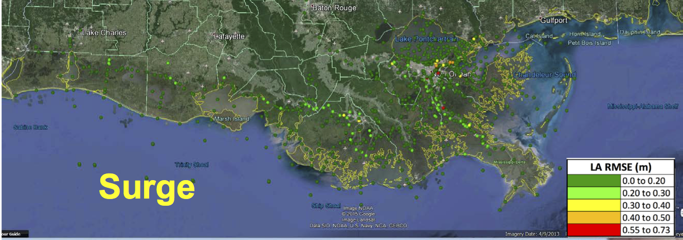
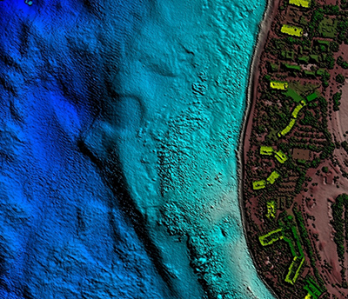
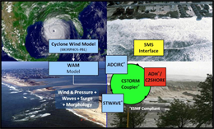
What is the role of data assimilation for Hurricane Flood Risk?
Background Bathymetry
UAS Hurricane Season
Hurricane Forecast
Pre-Storm UAS
Hurricane
Model Risk Assessment
JALBTCX (1-2 yrs)
Post Storm Assessment
Data Assimilation coupled to CSTORM for flood risk prediction

Slide 6
What is data assimilation for nearshore processes?
Estimate depths and other material properties for mobility in the nearshore
Combine direct estimation from measurements with data assimilation

Slide 7
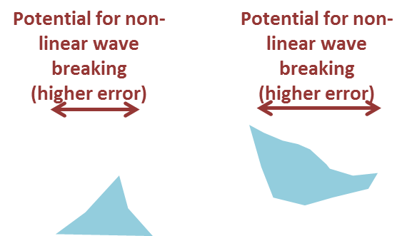
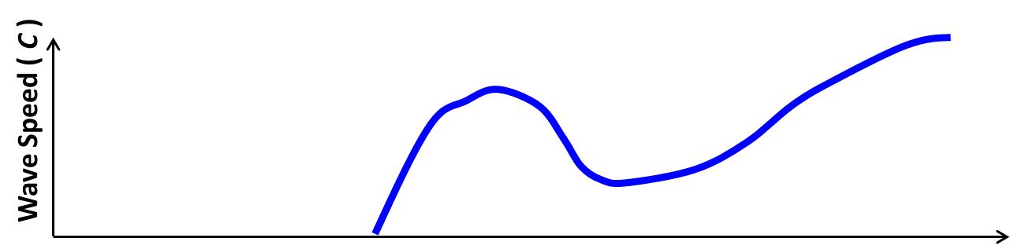
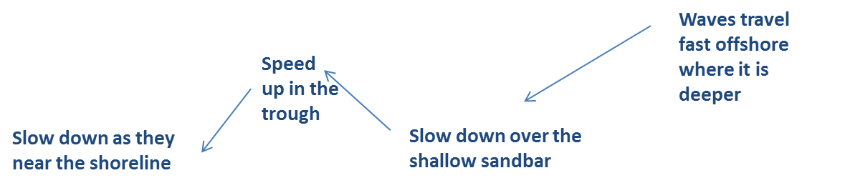
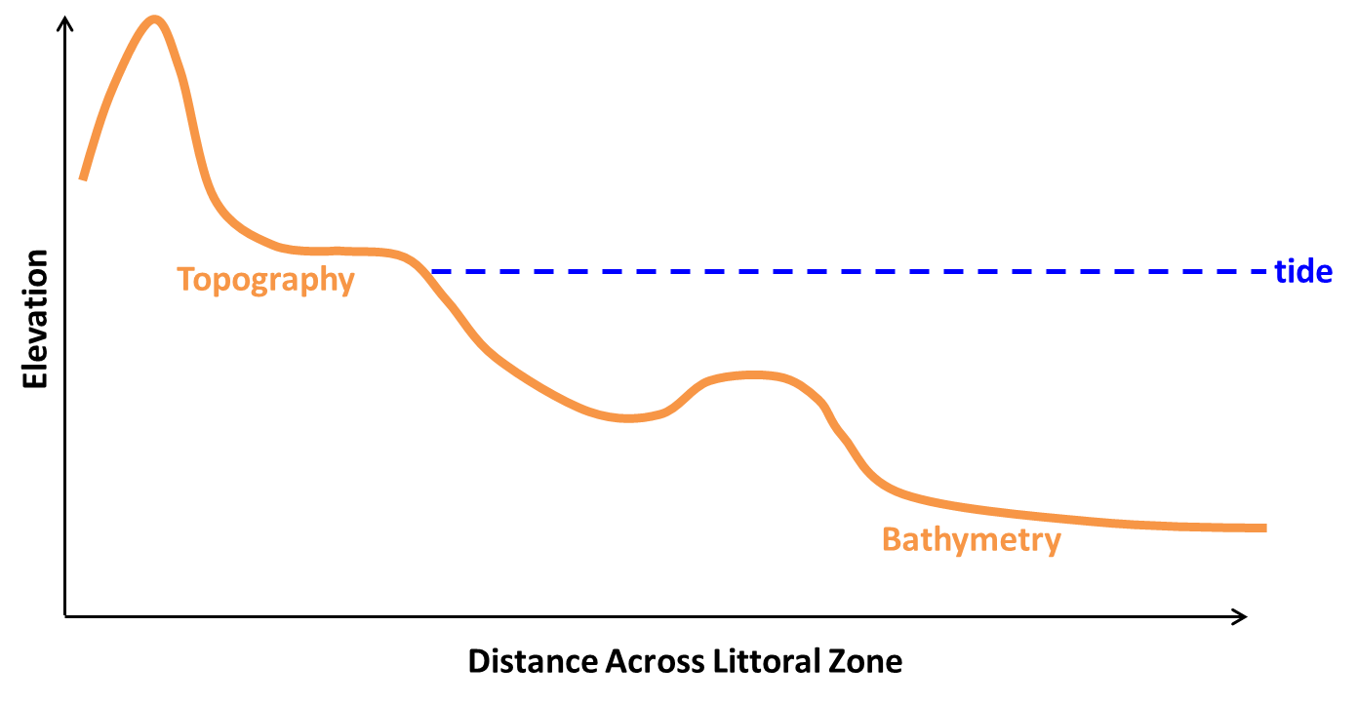
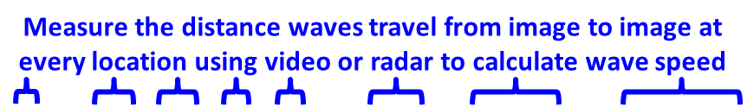


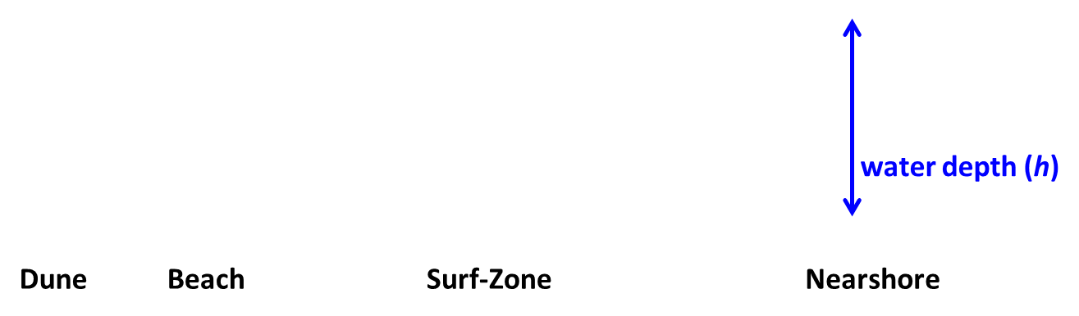
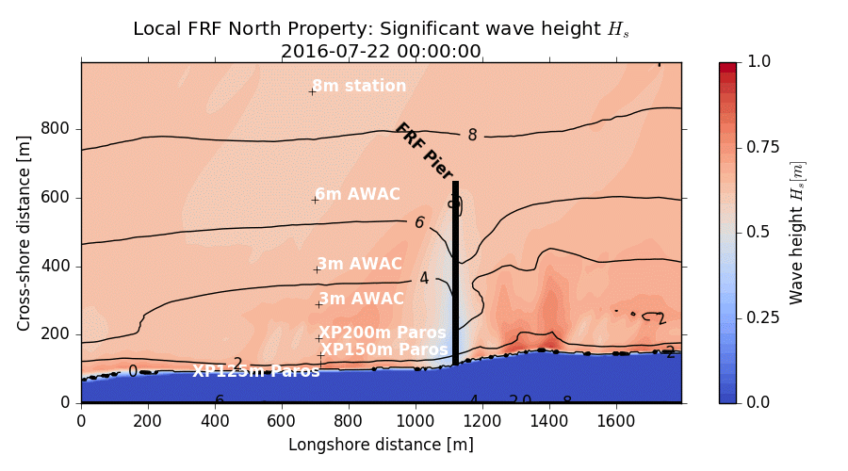
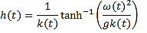
Surface Signature of Waves
As waves enter shallow water, they slow down.
By measuring these changes in speed, we can use physics equations to determine the water depth.
Linear
Dispersion Eqn:

Slide 8
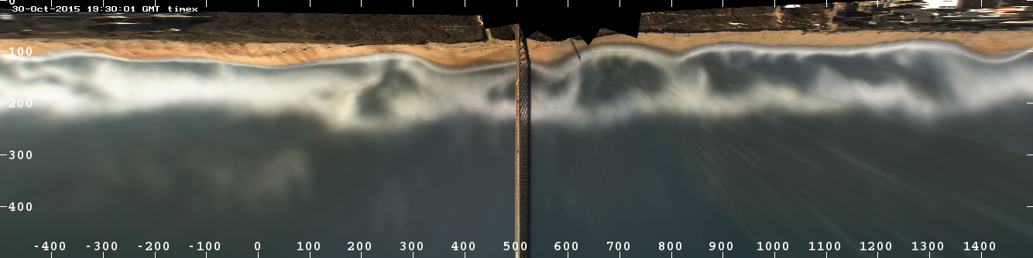
Surface Signature of Waves
Dissipation
As waves break energy is dissipated
Requires estimates of wave breaking dissipation from model to relate to depth
Energy loss from breaking at the shore
Energy loss from breaking over bar

Slide 9
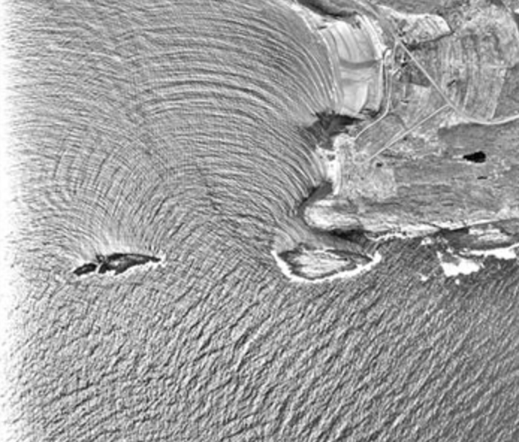
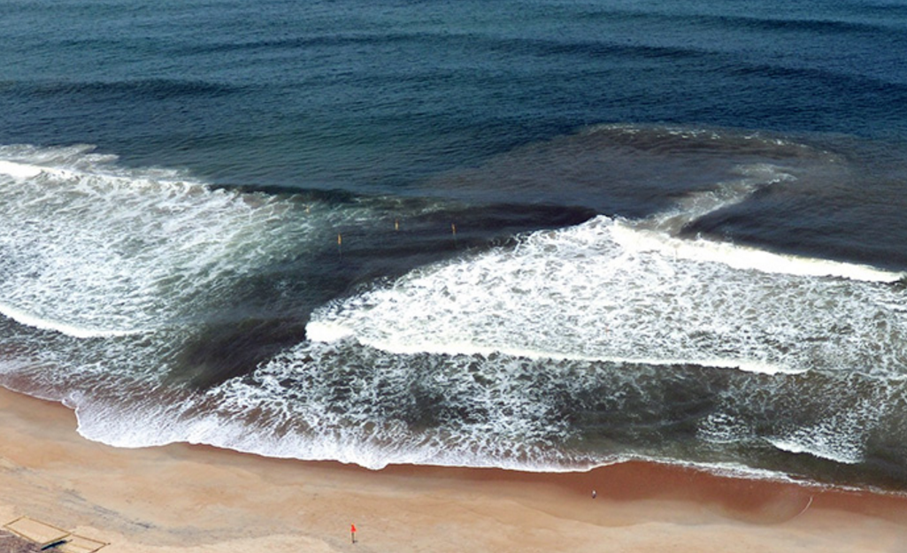
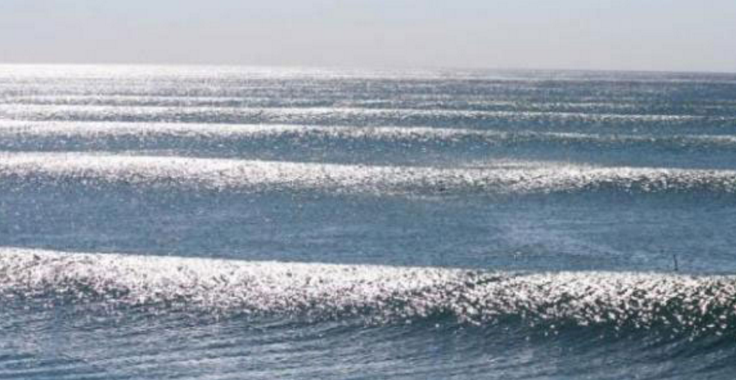
Difficulty with Inversion?
Inlet dynamics
Open Coast with rip currents
Open Coast
Inversion Difficulty
Physical Complexity

Slide 10
Nearshore Model Based Inversion
Observations
Data Assimilation Module
Boundary Forcing
Numerical Modeling Framework
Improved Bathymetry

Slide 11
Use of measurements for data assimilation
Topography
Breaking Dissipation
Wave speed

Slide 12
Nearshore Model Based Inversion
Observations
Data Assimilation Module
Boundary Forcing
Numerical Modeling Framework
Improved Bathymetry

Slide 13
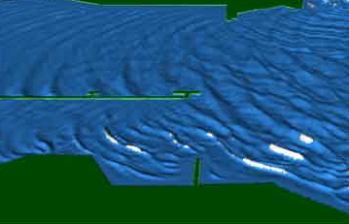
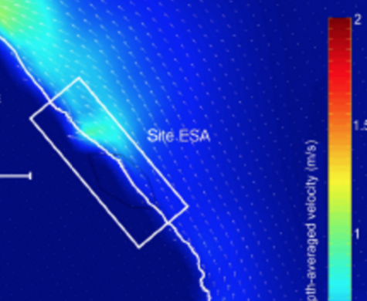
Nearshore Model Framework
Phase Resolving Models
Model Fidelity
Coupled Wave-Circulation
Phase Averaged Model
Computation Time
Linear Theory

Slide 14
Nearshore Model Based Inversion
Observations
Data Assimilation Module
Boundary Forcing
Numerical Modeling Framework
Improved Bathymetry

Slide 15
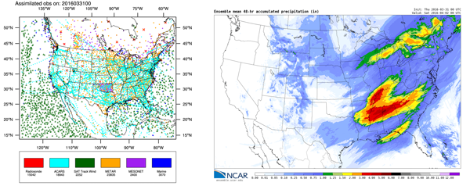
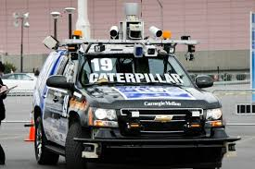
Data Assimilation
Data assimilation uses relationships between modeled and observed quantities to improve forecasts and predictions through measured data.
Collaborations with:
- Stanford University
- NC State University
- Oregon State University
to develop efficient and accurate data assimilation methods

Slide 16
What is the role of data assimilation for Hurricane Flood Risk?
Background Bathymetry
UAS Hurricane Season
Hurricane Forecast
Pre-Storm UAS
Hurricane
Model Risk Assessment
JALBTCX (1-2 yrs)
Post Storm Assessment
Data Assimilation coupled to CSTORM for flood risk prediction

Slide 17
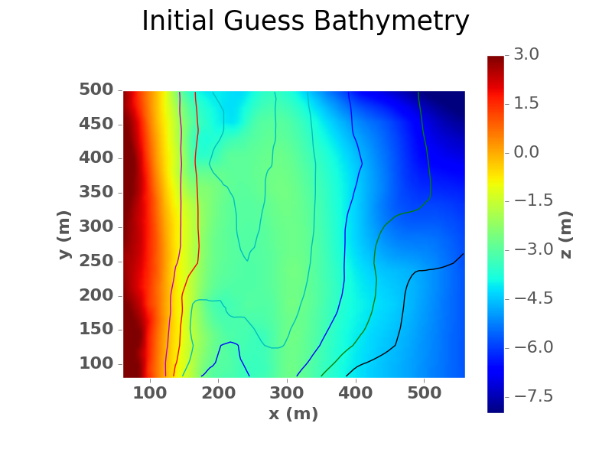
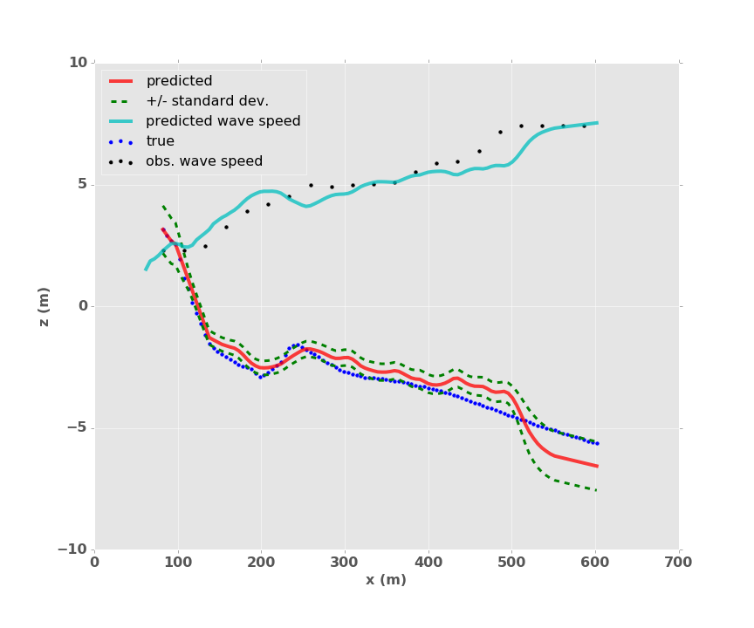
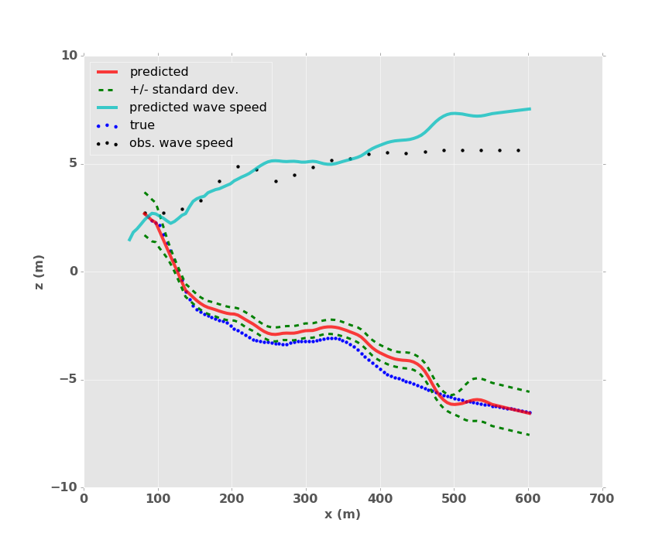

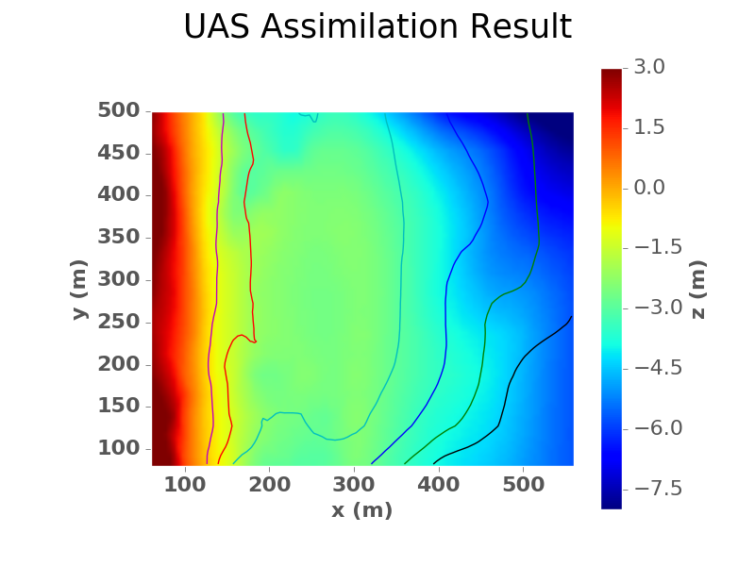
How does data assimilation from Uas for Flood Risk work?
Initial Bathymetry
6 months prior
UAS Assimilated Bathymetry

Slide 18
How does data assimilation from Uas for Flood Risk work?
Initial Bathymetry
6 months prior
UAS Assimilated Bathymetry

Slide 19
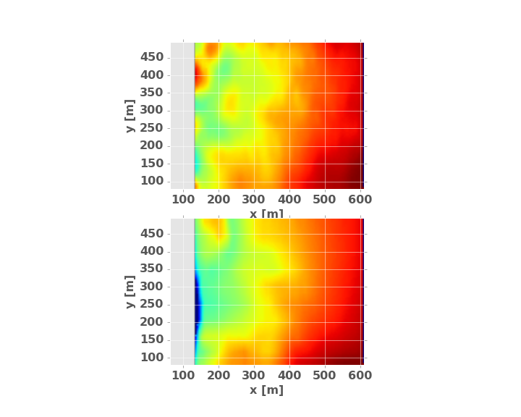
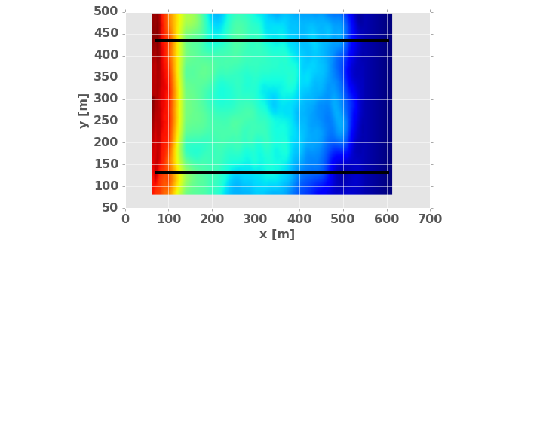
Data assimilation UAS Example
Profile result
Inverted bathymetry
Wave speeds
P1
P1
P2
P2

Slide 20
Nearshore Model Based Inversion
RIVERINE
Observations
Data Assimilation Module
Boundary Forcing
Numerical Modeling Framework
Improved Bathymetry

Slide 21
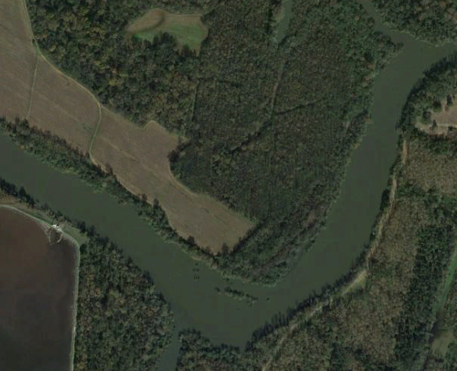
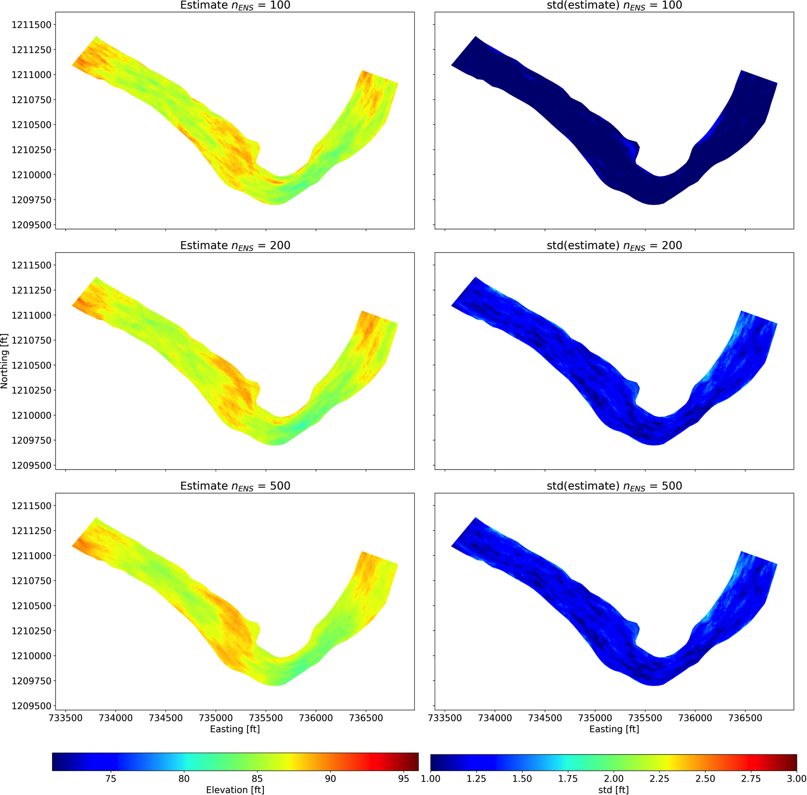
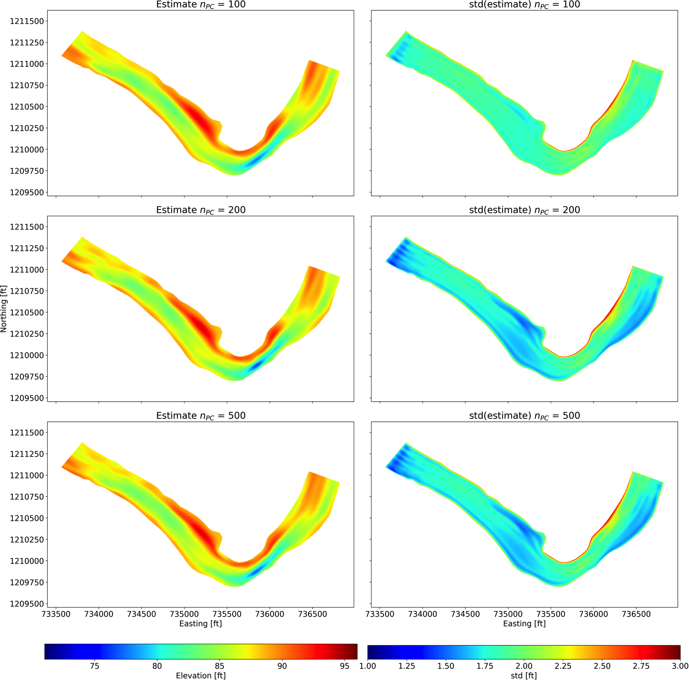
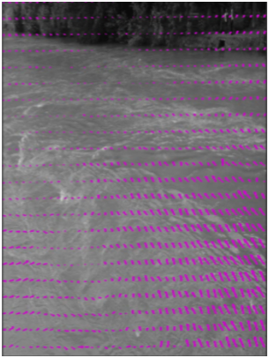
Riverine Assessment
Updated high
resolution estimates
of channel bathymetry
and flow conditions
Estimate bathymetry by optimizing the comparison of flow simulations in channels to observed surface currents
Novel inversion techniques that are robust for “snapshot” data
Savannah River, GA
Bathymetry Estimates and Uncertainty
Observed surface currents
Ensemble Kalman Filter
PCGA

Slide 22
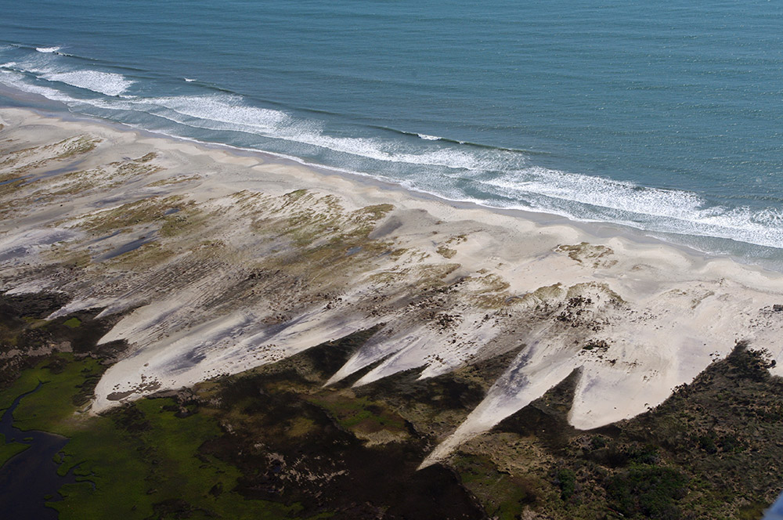
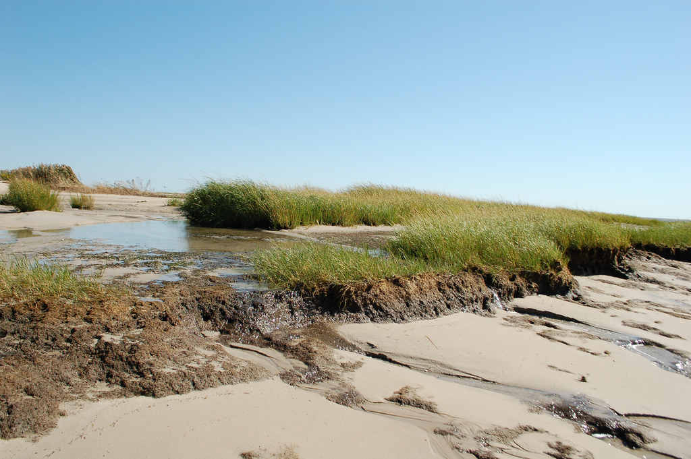
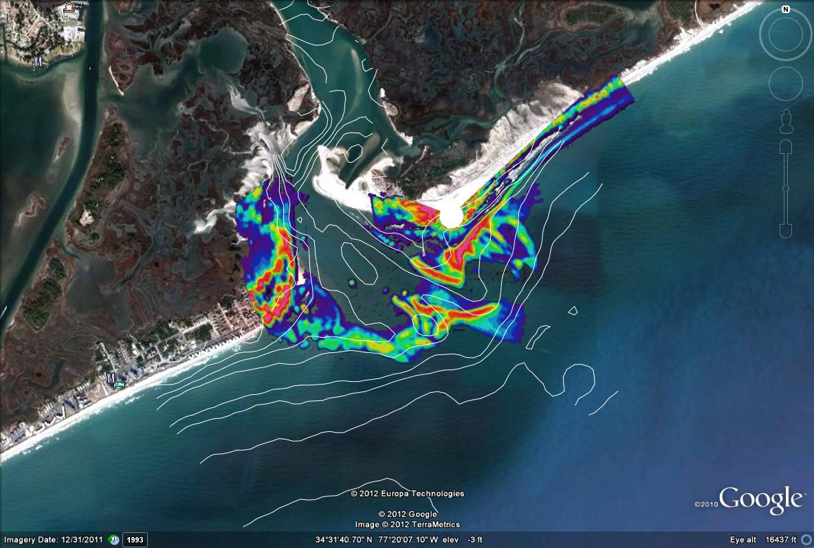
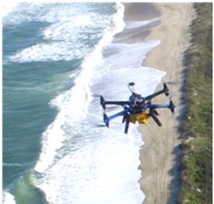
Future Work
Include higher fidelity models and morphology estimation
Include vegetation assessment from UAS into flood risk prediction
Improve assimilation in inlet dynamics and flood risk from back bay inundation.
Robustness over longer assimilation windows
Improved estimation of uncertainty

Slide 23


Could we use this technology to monitor nearshore morphology Evolution?
Background Bathymetry
Beach nourishment
UAS surveys
~ 1 month
Post placement survey
JALBTCX (1-2 yrs)
Post Placement Assessment
Data Assimilation for improved monitoring of morphology
Use numerical modeling to monitor environment (c2shore for morphology)

Slide 24
Questions?

